Slide 1
PROJECT TITLE – KEYLOGGER AND SECURITY
CAPSTONE PROJECT
Presented By:
1. Ritesh R-Jeppiaar Institute of Technology-Department of IT

Slide 2
OUTLINE
Problem Statement (Should not include solution)
Proposed System/Solution
System Development Approach (Technology Used)
Algorithm & Deployment
Result (Output Image)
Conclusion
Future Scope
References

Slide 3
Problem Statement
Design and develop a robust keylogger system with integrated security measures to protect sensitive user information from unauthorized access and potential breaches. The keylogger should be capable of recording keystrokes from various input sources, including keyboards and virtual keyboards, while ensuring the confidentiality, integrity, and availability of the logged data. Security mechanisms must be implemented to prevent the keylogged data from being intercepted or tampered with by malicious actors. Additionally, the system should offer features such as encryption, user authentication, access control, and regular security audits to safeguard against potential threats and maintain user privacy and trust. The goal is to create a reliable keylogging solution that enhances security measures without compromising user confidentiality or system usability.

Slide 4
Proposed Solution
System Architecture Design:
- Define a modular architecture comprising keylogging module, encryption module, authentication module, access control module, and auditing module.
Keylogging Module Implementation:
- Develop a robust keylogging component to capture keystrokes from various input sources, ensuring reliability and efficiency.
Encryption and Data Protection:
- Integrate encryption mechanisms using AES for encrypting logged keystrokes, ensuring confidentiality and integrity of data.
Authentication and Access Control:
- Implement user authentication using secure password hashing and role-based access control (RBAC) to restrict access to authorized users.
Security Monitoring and Auditing:
- Incorporate logging and auditing capabilities to track system activities, detect security incidents, and facilitate forensic analysis..

Slide 5
System Approach
The "System Approach" for keylogger and security:
Requirement Analysis
Design Architecture
Keylogging Module
Encryption and Data Protection
Authentication and Access Control
Security Monitoring and Auditing
Testing and Quality Assurance
Deployment and Maintenance

Slide 6
Algorithm & Deployment
Algorithm Selection:
Encryption Algorithm Selection ,Hashing Algorithm Selection, Digital Signature Algorithm Selection, Authentication Algorithm Selection and
Transport Layer Security (TLS) Protocol Selection
Data Input:
Keystrokes from Physical Keyboards, Input from Web Browsers and Online Forms, Input from Command-Line Interfaces (CLI) and
Input from Web Browsers and Online Forms
Training Process:
Data Collection and Preprocessing, Feature Extraction and Selection, Model Training and Evaluation Hyperparameter Tuning and
Model Deployment and Monitoring
Prediction Process:
Data Input and Preprocessing
Feature Encoding and Transformation
Prediction Generation
Post-processing and Output Generation

Slide 7
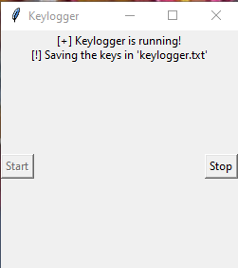
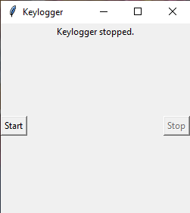

Result

Slide 8
Conclusion
The proposed keylogger system with integrated security measures presents a comprehensive solution to effectively capture and protect sensitive user information while maintaining confidentiality, integrity, and availability. By implementing a modular architecture, robust encryption mechanisms, stringent authentication and access control measures, and comprehensive security monitoring, the system ensures that logged data remains secure from unauthorized access and tampering.
The development process involves careful consideration of algorithm selection, system design, implementation, testing, and deployment, with a focus on adhering to best practices in security and privacy. Continuous monitoring and maintenance are essential to address evolving security threats and vulnerabilities, ensuring the ongoing effectiveness of the system.
Overall, the proposed solution provides a reliable and secure keylogging solution that enhances security measures without compromising user privacy or system usability. With proper implementation and adherence to security protocols, the keylogger system can serve as a valuable tool for monitoring user activities while maintaining the highest standards of security and data protection.

Slide 9
Future scope
Blockchain Technology: Explore the potential use of blockchain technology to enhance data integrity, auditability, and transparency in logging and auditing processes, ensuring tamper-proof records of user activities.
Enhanced Security Measures: Continuously research and integrate advanced encryption techniques, authentication methods, and access control mechanisms to stay ahead of emerging security threats..
Behavioral Biometrics: Investigate the incorporation of behavioral biometrics, such as keystroke dynamics, for user authentication and identification, enhancing security while minimizing user inconvenience.

Slide 10
References
"Principles of Cyber-Physical Systems Security: A Reference Guide“ by Ronald L. Krutz, Russell Dean Vines Published by Wiley in2019

Slide 11
THANK YOU

